Slide 1

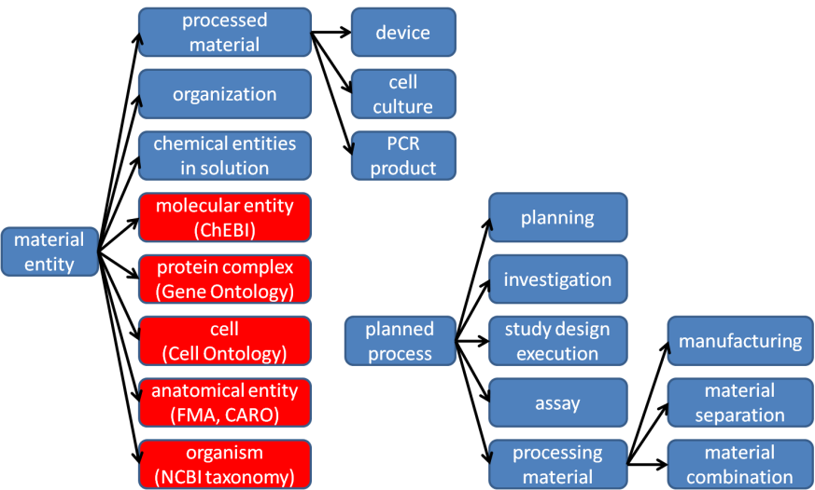
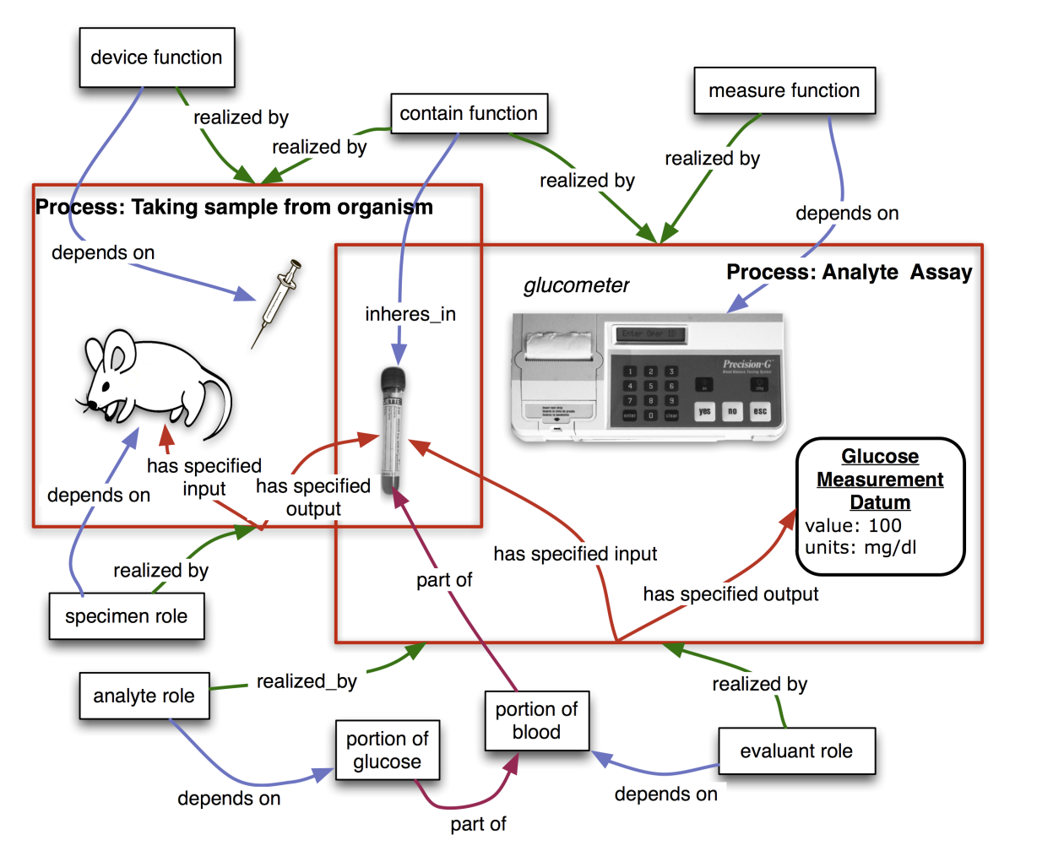
Ontology for Biomedical Investigations
The OBI Consortium*, http://obi-ontology.org email: obi-users@googlegroups.com
The goal of OBI is to enable a formal representation of biomedical investigations that captures the experimental evidence on which their findings are based. OBI allows for the comparison of experimental data from the wide array of scientific disciplines represented by domain experts in the OBI consortium. OBI follows the principles laid out by the OBO foundry, and integrates tightly with other foundry candidate ontologies, such as GO (www.geneontology.org) and ChEBI (www.ebi.ac.uk/chebi/) whose terms are used to describe biological reality. The use of OBI by the scientific community to represent or annotate their investigations within electronic data resources will alleviate the need for lower accuracy text mining and enable semantic web searches and third-party understanding of information related to life-science and clinical investigations.
Partial high-level is-a hierarchy of OBI classes.
Under the Basic Formal Ontology (BFO) (www.ifomis.org/bfo) material entity, several classes are imported from outside ontologies (indicated in red). The processed material class represents entities that were generated in a planned process, meaning that they were intentionally created.
planned process are initiated by an agent in order to achieve a specific objective. This includes all research activities, such as an investigation encompassing a planning, study design execution and documenting phase, or an individual assay.
A detailed example how to represent a blood glucose concentration measurement
Measuring the glucose concentration in blood. The large boxes represent processes and contain their participants. The taking sample from organism process takes place first. In this process, a syringe is used as a device to draw blood from the mouse which bears the specimen role. At the end of this process, a tube contains the blood specimen. In a second step, that blood will be used as the evaluant in an analyte assay in which the concentration of glucose in the blood is measured. A glucometer device is used to make this measurement. The analyte role inheres in the glucose molecules scattered throughout the blood specimen. The objective of this planned process is to analyze the analyte (glucose) concentration. This modeling of a specific use case is used as the basis for generation of pattern templates allowing us to automate following additions of similar processes
* The OBI consortium is (in alphabetical order): Ryan Brinkman, Bill Bug, Helen Causton, Kevin Clancy, Christian Cocos, Mélanie Courtot, Dirk Derom, Eric Deutsch, Liju Fan, Dawn Field, Jennifer Fostel, Gilberto Fragoso, Frank Gibson, Tanya Gray, Jason Greenbaum, Pierre Grenon, Jeff Grethe, Yongqun He, Mervi Heiskanen, Tina Hernandez-Boussard, Philip Lord, Allyson Lister, James Malone, Elisabetta Manduchi, Luisa Montecchi, Norman Morrison, Chris Mungall, Helen Parkinson, Bjoern Peters, Matthew Pocock, Philippe Rocca-Serra, Daniel Rubin, Alan Ruttenberg, Susanna-Assunta Sansone, Richard Scheuermann, Daniel Schober, Barry Smith, Larisa N. Soldatova, Holger Stenzhorn, Chris Stoeckert, Chris Taylor, John Westbrook, Joe White, Trish Whetzel, Stefan Wiemann, Jie Zheng.

